Slide 1
Nanomaterials:
Structure, Properties and Applications:
Graphene
Quantum dots (semiconductor nanoparticles)

Slide 2
Nanomaterials: Graphene
Structure: Dimensionality, Details of Carbon atoms
arrangement and bonding, Figure (sheet)
Properties: Chemical, Physical or Mechanical, Electrical property (electronics) and optical property, thermal conductivity etc.
Applications: Potential uses based on different properties

Slide 3
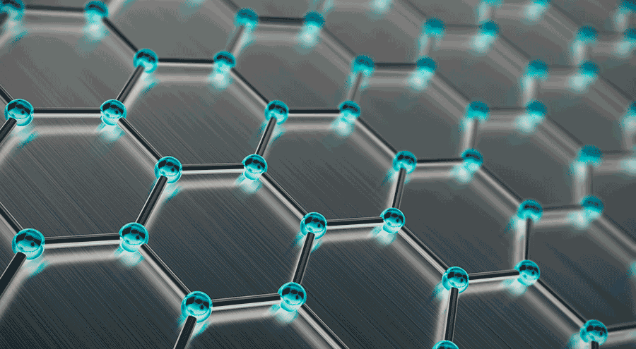
Graphene
Discovered in 2003,
an allotrope of Carbon
Single atom-thick layer of tightly bonded Carbon atoms, arranged in flat hexagonal lattice structure
Honeycomb like structure
Dimensionality: 2D (atomic thickness: 0.345 nm)
All Carbon atoms are sp2 hybridized

Slide 4
Graphene: Chemical Properties
An inert material and does not readily react with other atoms (Even though all of graphene’s atoms are exposed to the environment). However, “absorb” different atoms and molecules. This can lead to changes in the electronic properties.
Can also be functionalized by various chemical groups, which can result in different materials such as graphene oxide (functionalized with oxygen and helium) or fluorinated graphene (functionalized with fluorine).

Slide 5
Graphene: Physical Properties
One of the thinnest (only one carbon atom thick ~0.34 nm)
Flexible material; most stretchable crystal (stretch upto 20% initial size w/o breaking it)
Toughest 2D material—much harder than either steel (200 times stronger than steel) or diamond of the same dimensions
High tensile strength
Lightweight; it weighs just 0.77 mg/m²
Highest surface area, since single 2D sheet
Highly impermeable (even helium atoms cannot go through it)
Available in variety of forms: it can be wrapped into balls, rolled into tubes, or stacked to become graphite once again

Slide 6
Graphene: Electrical Properties
High electrical current density (million times that of copper) and intrinsic mobility (100 times that of silicon)
Lower resistivity than any other known material at room temperature, including silver.
There are also some methods to turn it into a superconductor (it can carry electricity with 100% efficiency)
Although graphene, the fastest and most efficient conductor, it cannot be readily used to make transistors as it does not have a bandgap. There are several methods to open a bandgap that are in existence and some that are under development
Perfect thermal conductor – Higher than that of CNT, graphite and diamond (over 5,000 W/m/K).
Conducts heat in all directions - it is an isotropic conductor

Slide 7
Graphene: Optical Properties
Extremely thin, but still a visible material, as it absorbs about 2.3% of white light (which is quite a lot for a 2D material) i.e. 98% of visible light passes through graphene, making it transparent
Combine this with graphene’s amazing electronic properties, and it turns out that graphene can theoretically be used to make very efficient solar cells
In addition, absorbing 2.3% of visible light still makes graphene very much transparent to the human eye, which may have various uses
eg. Used to make transparent conductors

Slide 8
Potential Uses of Graphene
Water Filtration Systems: For purification of water as it allows water to pass, but not other liquids and gases Touch Screens in Devices: Transparency and conductivity of graphene can be used in displays and touchscreens, however more expensive to produce than currently used indium tin oxide
In Electronic Devices: Touted as Siliocon’s successor and has been used to make very fast transistors. However, its conductivity cannot be switched off as Silicon can.
Medical Sensors & Drug delivery: Several biomedical
applications are being explored for graphene, including drug delivery, cancer therapy and as a sensor. However, its toxicity profile must be investigated before clinical use Energy Storage & Composites: Used in normal batteries as a substitute for graphite

Slide 9
Nanomaterials: Quantum Dots
Introduction: Definition, Common QD materials (group)
Structure: Dimensionality,
General Feature: Effect of Interaction of UV light with different sizes
Quantum confinement (Semiconductor): Band gap tuning by size (splitting of energy levels due to size/composition) Figure required for energy level with respect to size of QD
Properties: Electronic and Optical property
Applications: Different domains like biological (Bioimaging), photvoltic devices (solar cells), electronics (Light emitting devices) etc.

Slide 10
Nanomaterials: Quantum Dots
Definition: Quantum dots (QDs) are often referred to very tiny man-made semiconductor nanoparticles/structures that exhibit 3 dimensional quantum confinement, which leads to many unique optical and transport properties , whose size are normally no more than 10 nanometers (2-10nm)
Structure: 0 dimensional (0D) nanostructure;
Electron-hole pair is confined on all 3 spatial dimensions renders the materials to exhibit size dependent color variation
Examples: Typically, QD composed of the elements of periodic groups II-VI, III-V and IV-VI materials like CdSe, CdS₂,InSe, PbSe, InP, GaAs, CdSe/Zns etc.

Slide 11
Nanomaterials: Quantum Dots
General feature: When illuminated by UV light, some of the electrons receive enough energy to break free from the atoms.
This capability allows them to move around the nanoparticle, creating a conductance band in which electrons are free to move through a material and conduct electricity. When these electrons drop back into the outer orbit around the atom (the valence band), they emit light.
The color of that light depends on the energy difference between the conductance band and the valence band
A majority of QDs have the ability to emit light of specific wavelengths if excited by light or electricity.
The electronic characteristics of QDs are determined by their size and shape, which means we can control their emission wavelengths by tuning their size.

Slide 12
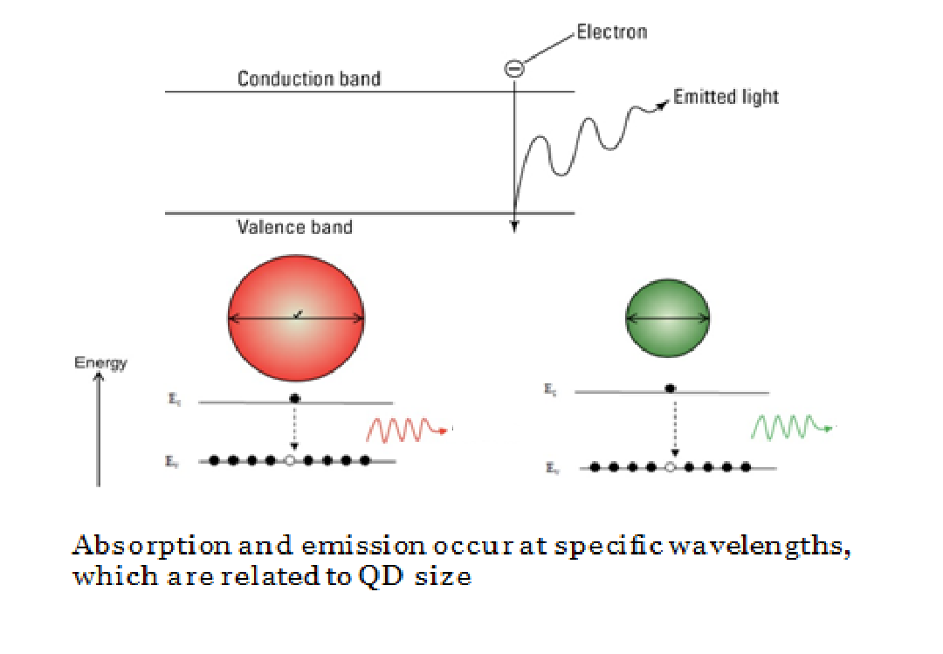

Slide 13
Nanomaterials: Quantum Dots
Quantum Confinement: What does it mean?
Change of electronic and optical properties when the material sampled is of sufficiently small size - typically 10 nanometers or less
QDs are bandgap tunable by size which means optical and electrical properties can be engineered to meet specific applications
Smaller QDs have a large bandgap
Typically, smaller QDs (e.g., radius of 2~3 nm) emit shorter wavelengths generating colors such as violet, blue or green. While bigger QDs (e.g., radius of 5~6 nm) emit longer wavelengths generating colors like yellow, orange or red.
Absorbance and luminescence spectrums are blue shifted with deceasing particle size

Slide 14
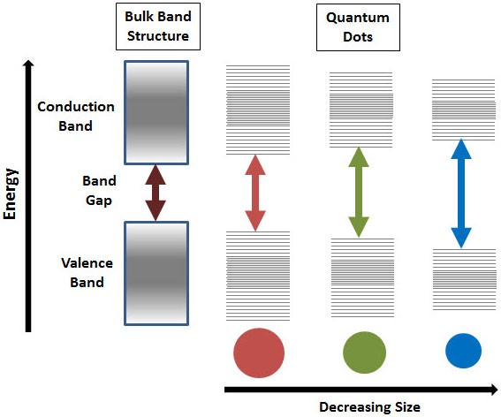
Effect of quantum confinement: Splitting of energy levels in QD
Semiconductor band gap increases with decrease in size of the nanocrystal

Slide 15
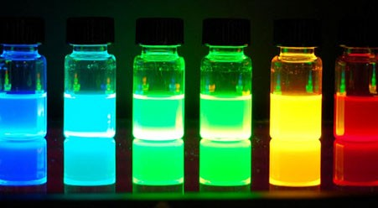
Photoluminescence of alloyed CdS_{x}Se_{1-x}/ZnS quantum dots of 6nm diameter. The material emits different color of light by tuning the composition

Slide 16
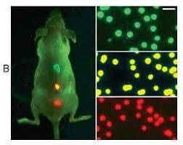
Potential Uses of Quantum Dots
BioImaging: QDs are coated with hydrophilic polymers and also be conjugated to obtain mulifunctionality. They can be linked with biological agents such as antibodies, peptides, oligonucleotides, inhibitor molecules etc.
E.g. QDs can be used in cancer detection. Detection of tumor in human body,
Multicolour Imaging of the tumor tissue by QDs in live animals In-vivo imaging poses problems with the clearence of the particles from body. Toxicity and hazards effects yet to be evaluated thoroughly
A broad absorption and narrow emission Spectrum means a single excitation source
can be used to excite QDs of different colors imaging multiple targets simultaneously.
Source: https://googleimages.com/
making them ideal for

Slide 17
Potential Uses of Quantum Dots
Light Emitting Diodes
Quantum dot light emitting diodes (QD-LED) and ‘QD-White LED’ are
very useful when producing the displays for electronic devices because they emit light in highly specific Gaussian distributions. QD-LED displays can render colors very accurately and use much less power than traditional displays.
Quantum-dot-based LEDs are characterized by pure and saturated
emission colours with narrow bandwidth, and their emission wavelength is easily tuned by changing the size of the quantum dots
Solar Cells
Quantum dot (QD) solar cells have the potential to increase the maximum attainable thermodynamic conversion efficency of solar photon conversion up to about 66% by utilizing hot photogenerated carriers to produce higher photovoltages or higher photocurrents

Slide 18
Potential Uses of Quantum Dots
Alternative to traditional Dyes
Quantum dots are an attractive alternative to traditional organic dies because of their high quantum yield and photostability. Quantum dots have a high quantum yield because they have a high density of energy states near the bandgap.
– A higher quantum yield means a brighter emission. The quantum yield of some QDs is 20 times greater than traditional organic fluorophores

